Slide 1
Expense Claim Details Module
Group 4
Mentor: Vaishali Srivastava

Slide 2
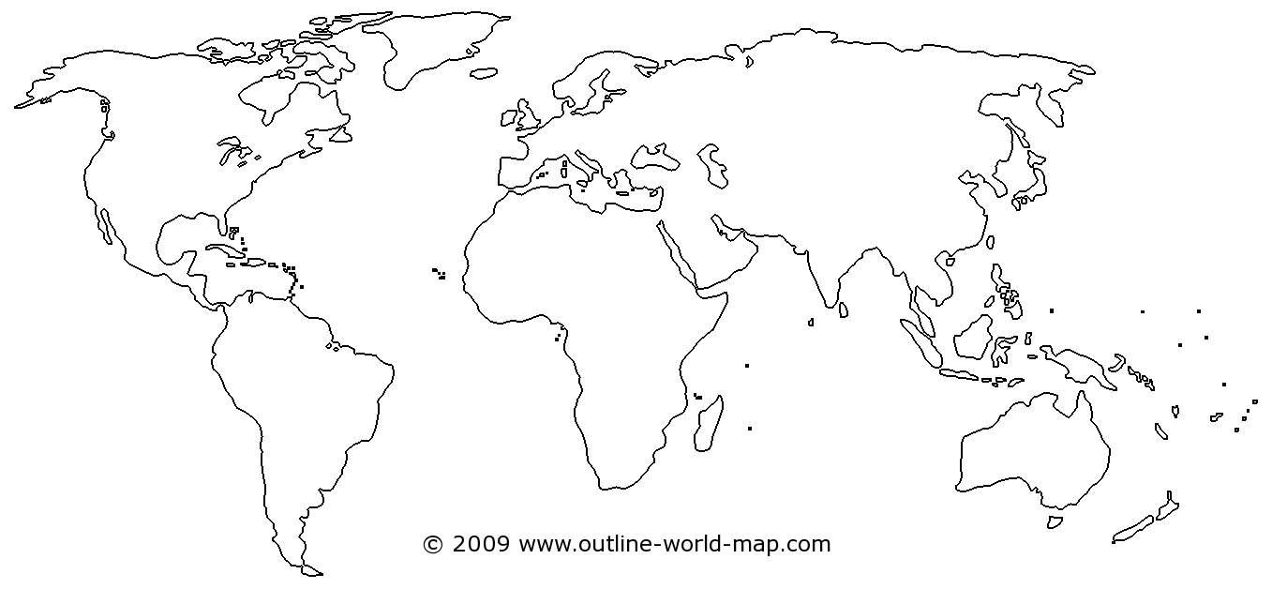
Objectives
Project Understanding
Approach Used
Project Execution
Modules
Demo Code and Walkthrough
Q&A

Slide 3
Project Understanding
The project is to develop an Expense Management System as integration of all independent micro services.
Document contains the work flow of the system and gives guidelines on how to build the functionality gradually in each of the course modules.
The functionality of this module is to integrate the micro services, i.e. Employee Code Module, Project Code Module and Expense Code Module.
The portal is created through which a user can claim, view, update and delete the expense.

Slide 4
Approach Used
Front End & Web Components:
Postman
Business Logic Components and Services :
Java Beans, Spring, REST Web Service
Application Servers :
Eureka
Databases:
MongoDB

Slide 5
Project Execution
To integrate the three micro services, i.e. Employee Code Module, Project Code Module and Expense Code Module.
Verify employee details based on Employee ID.
Verify project details based on project code.
Verify expense code details based on expense code.
A user can claim, view, update and delete the expense.

Slide 6
Module
Claim an Expense:
Enter the Employee ID. If valid, the corresponding details will be fetched from Employee Code Module and displayed.
Else, the error message will be displayed and the user will not be able to proceed further.
Enter the Project Code. The corresponding details will be fetched from Project Code Module and displayed.
Select Expense Code from drop down list. The details will be fetched from Project Code Module and displayed.
Enter some additional details, i.e. Start Date, End Date, Expense Amount, etc. These details, along with some required details of other micro services (Employee ID, Project Code and Expense Code) will be stored into the database.
The Expense Code ID will be auto generated and displayed on the screen.

Slide 7
Module
Enter the Expense Code ID:
If valid, the corresponding details will be displayed.
Else if the ID is wrong, the error message will be displayed.
Update an Expense Claim:
Enter the Expense Code ID.
If valid, the details will be displayed and user will be able to modify the details wherever required.
Else if the ID is wrong, the error message will be displayed.
Delete an Expense Claim:
Enter the Expense Code ID.
If valid, all the corresponding details will be deleted from the database.
Else if the Id is wrong, the error message will be displayed.

Slide 8
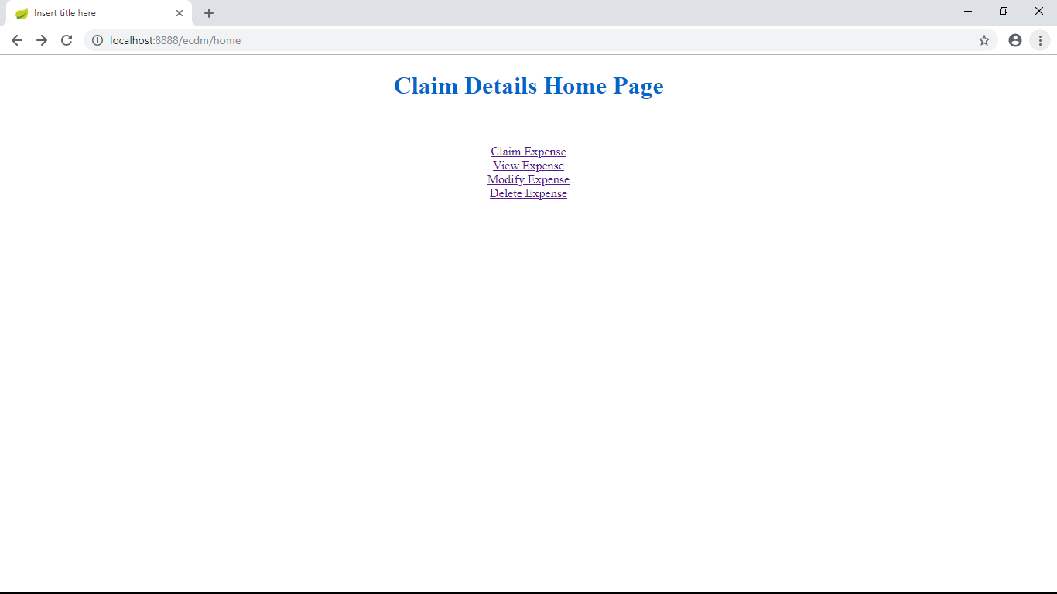
Demo and Code Walkthrough

Slide 9
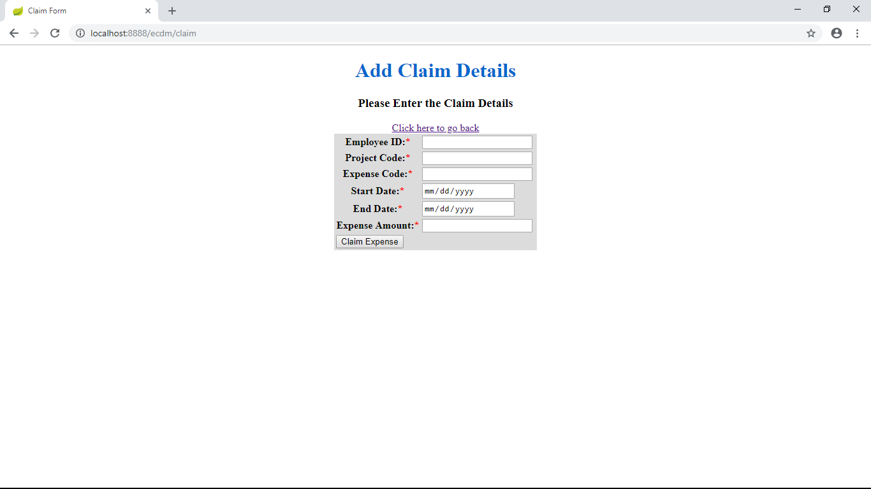
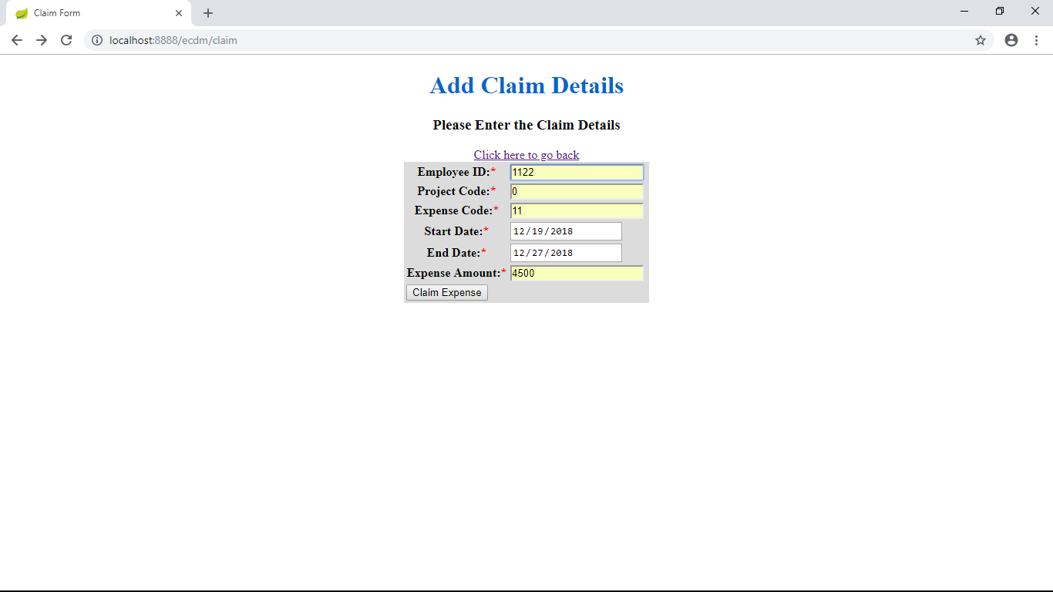
Demo and Code Walkthrough

Slide 10
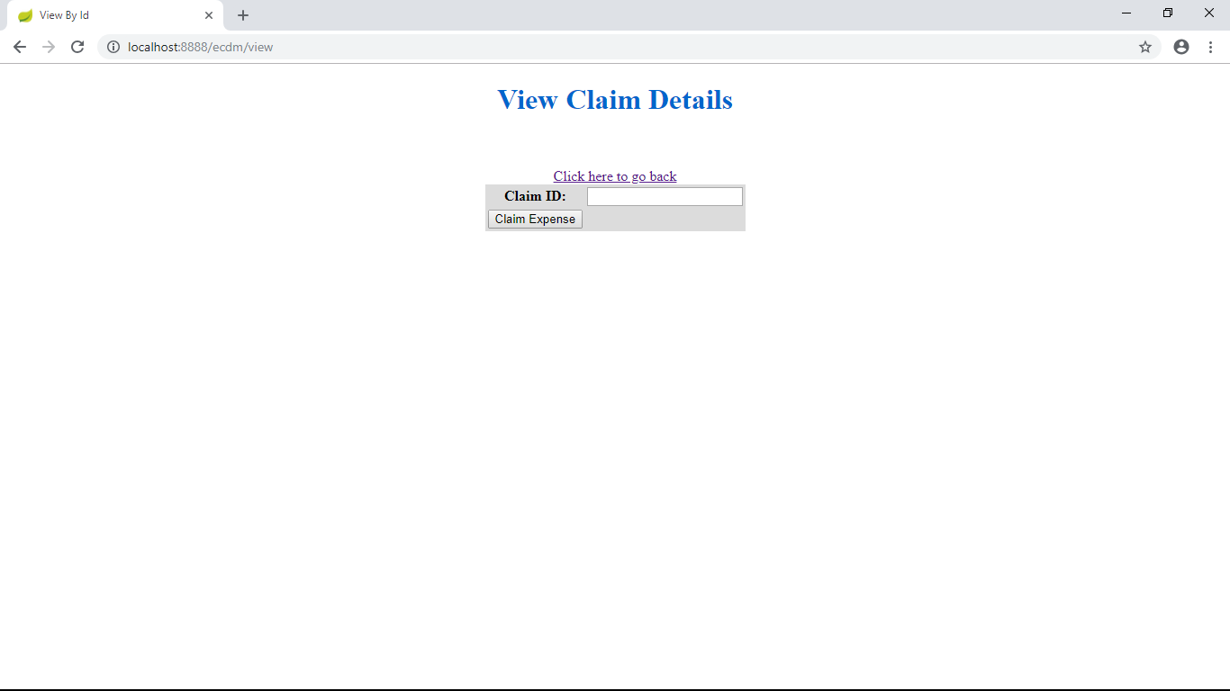
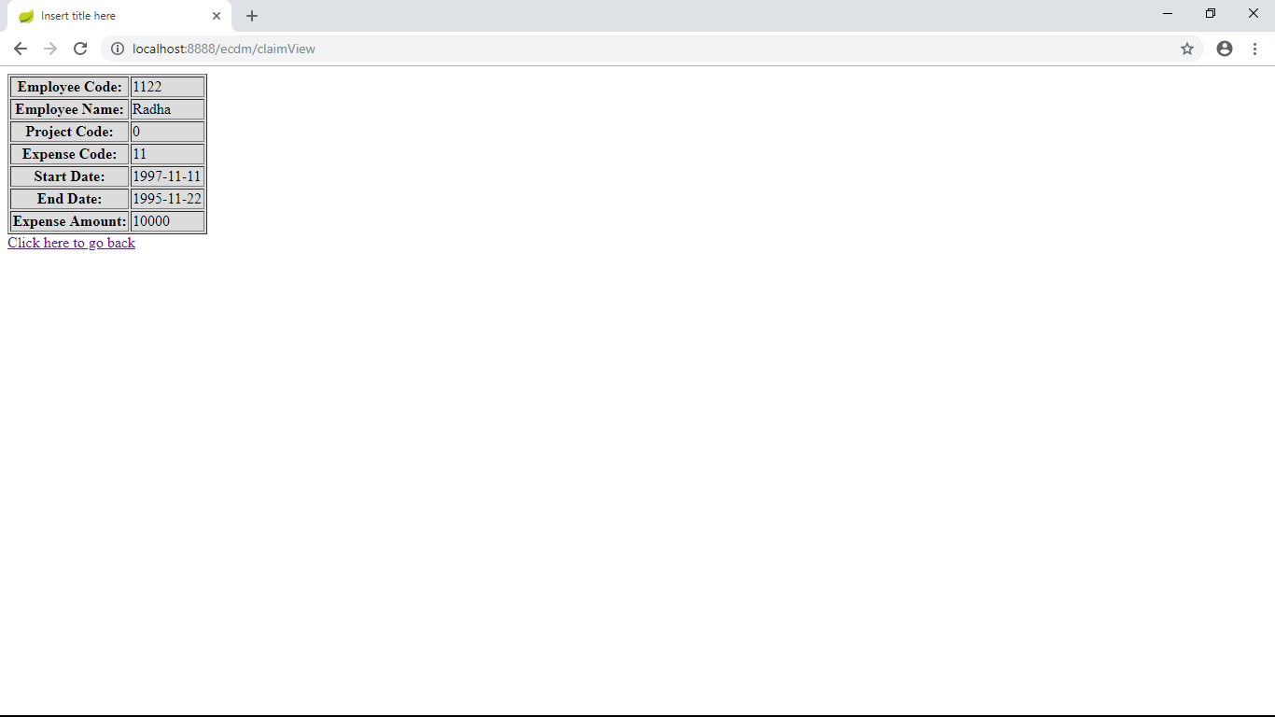
Demo and Code Walkthrough

Slide 11
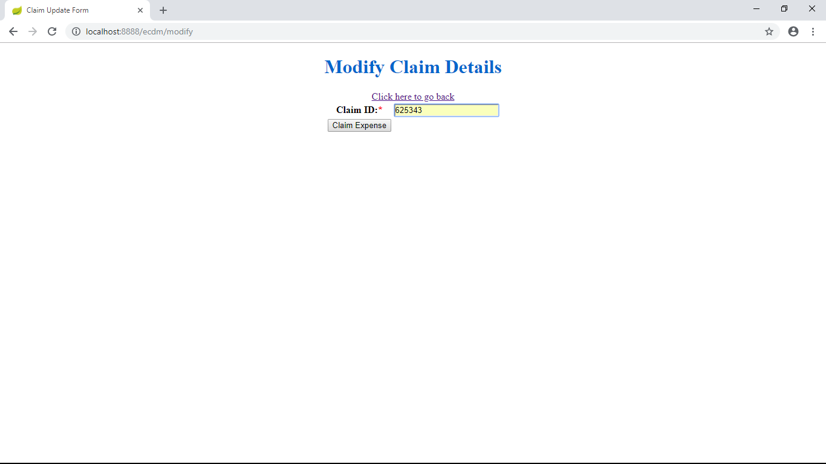
Demo and Code Walkthrough

Slide 12
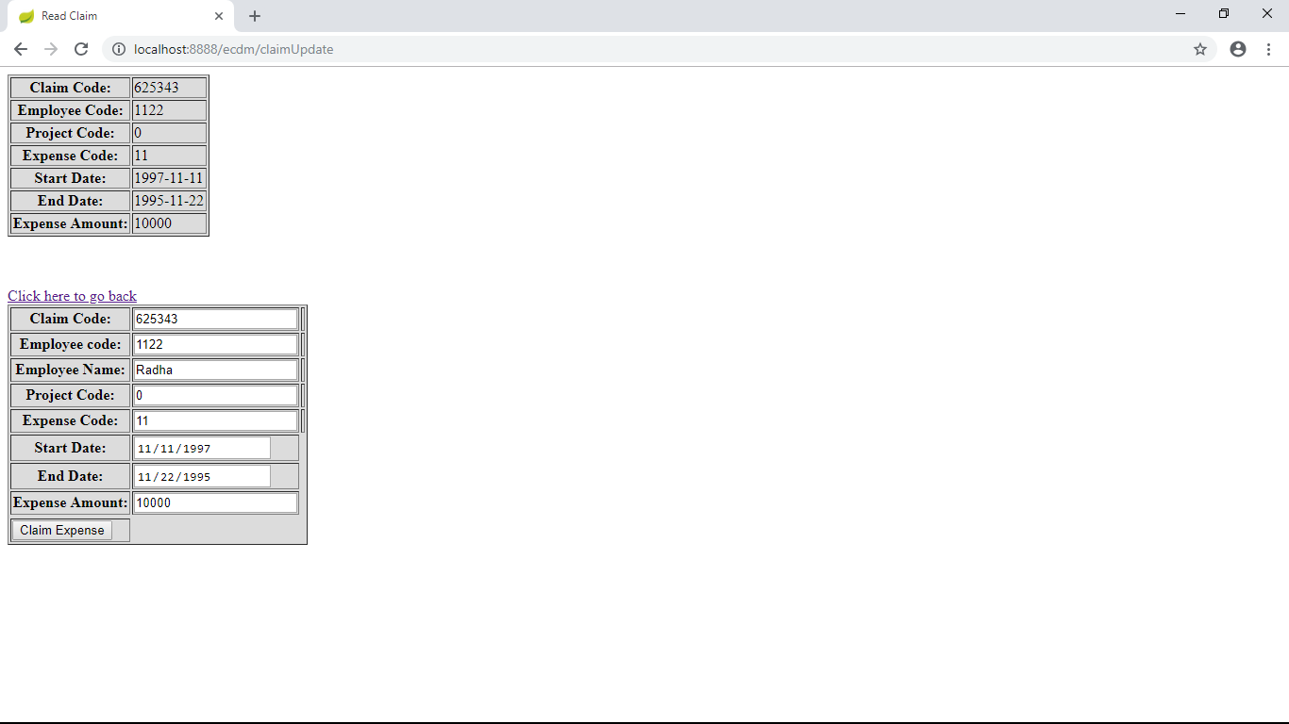
Demo and Code Walkthrough

Slide 13
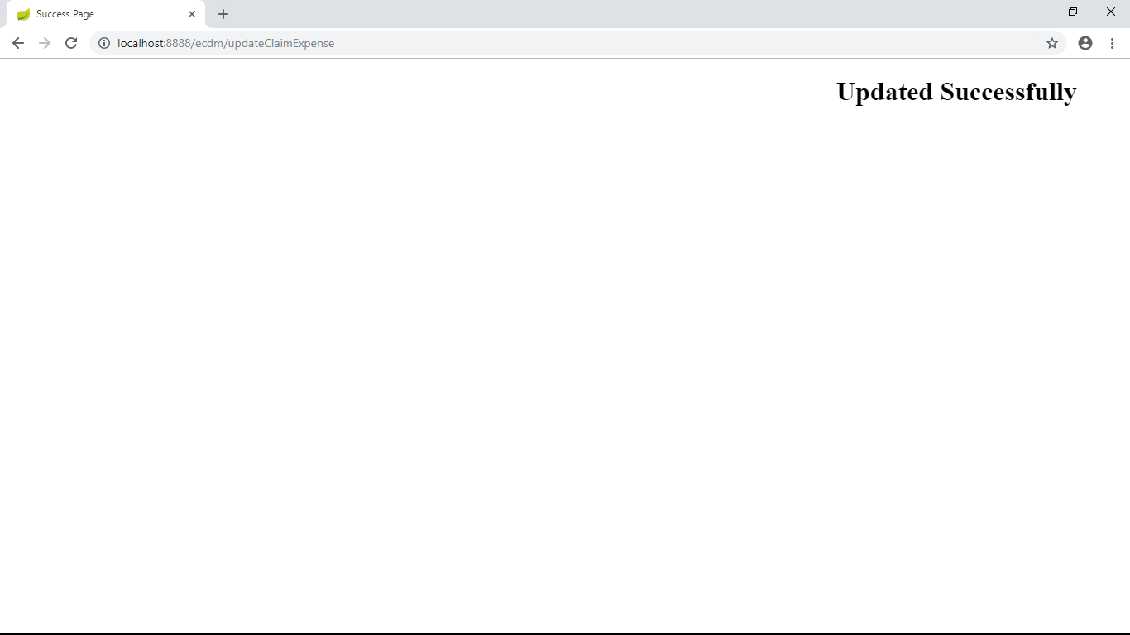
Demo and Code Walkthrough

Slide 14

Demo and Code Walkthrough

Slide 15
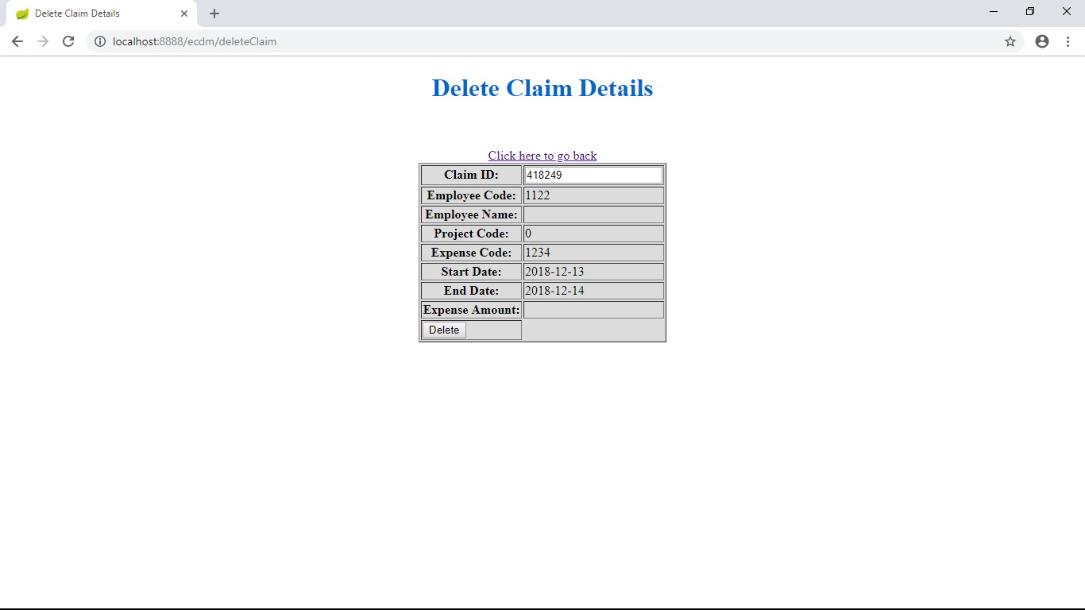
Demo and Code Walkthrough

Slide 16
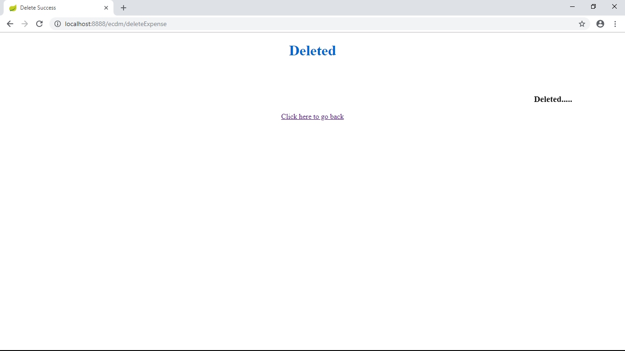
Demo and Code Walkthrough

Slide 17
THANK YOU

